Slide 1
RAGgady
Michael Blithe
SWENG 837

Slide 2
System Context
Connecting:
User’s data
Tools
Generative AI
RAGgady
Notes:
The main system is to support is enabling users to utilize the vast amounts of data they have with their lives already and combine that with generative AI along side AI invoked tool to create a powerful trinity of functionality, each of the circles in RAGgadys logo represents one of these pillars of functionality. The main functionality is to support a variety of tools, AI providers as well as formats for ingestion, including PDFs, markdown, HTML, image files and more. Non-Functional Requirements and Maintainability requirements are detailed in the accompanying report but the main focus of those requirements are to constrain the data artifact sizes, the performance and availability requirements. Further, the maintainability requirements are focused on using automated tooling to ensure DEVSEC OPS with automated scans and testing requirements.

Slide 3
Type | Actor
Primary | Personal User
Primary | Business User
Primary | System Administrator (Sys admin)
Supporting | Generative AI provider
Supporting | 3rd Party Data Provider
Offstage | Payment Processor
Offstage | Government Regulator
Notes:
These are our key actors, the most notable are our primary actors, it includes a persona and a business user. The difference between the two is an overall data volume need, as well as the sharability of the data. The Business user has needs for Role based access controls (RBAC) meanwhile the personal user only has access to their own data. The Gen AI provider is considered external as well as the data provider. The data provider may be as simple as the user’s own computer or may be their financial provider so they can make informed personal finance decisions.

Slide 4
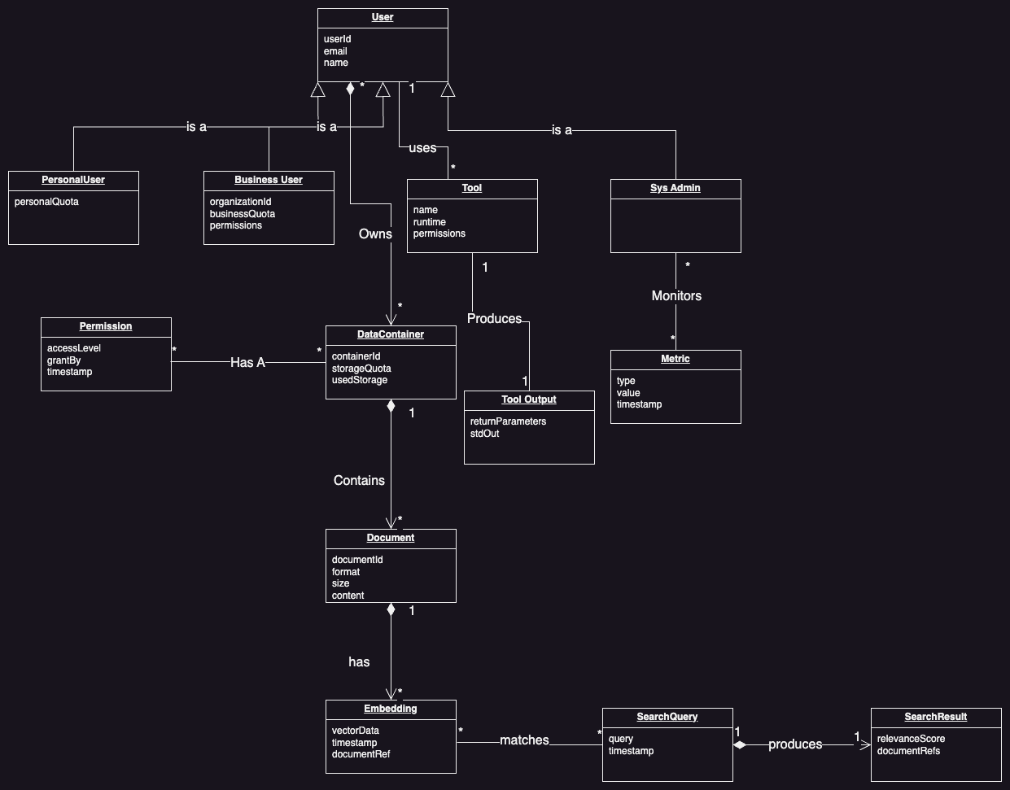
Domain Model

Slide 5
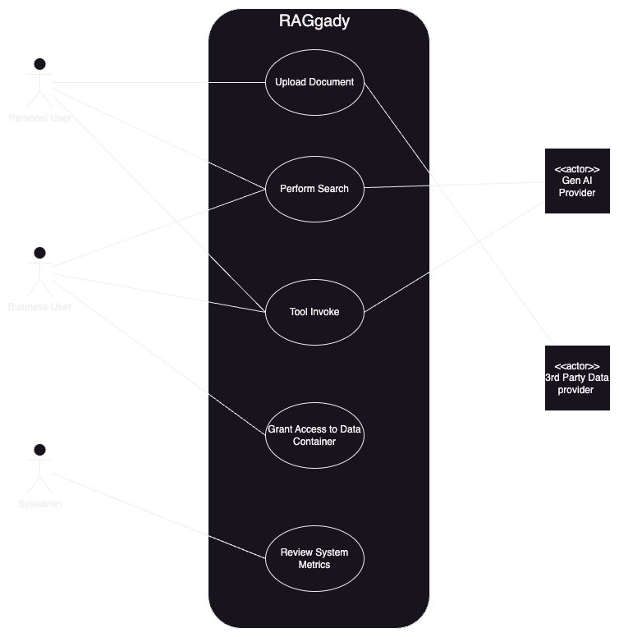
Use Case Diagram
Notes:
Here’s our Use case diagram for the System, I’ll be discussing each briefly using a real-life example but a complete success path is described in the full report.

Slide 6
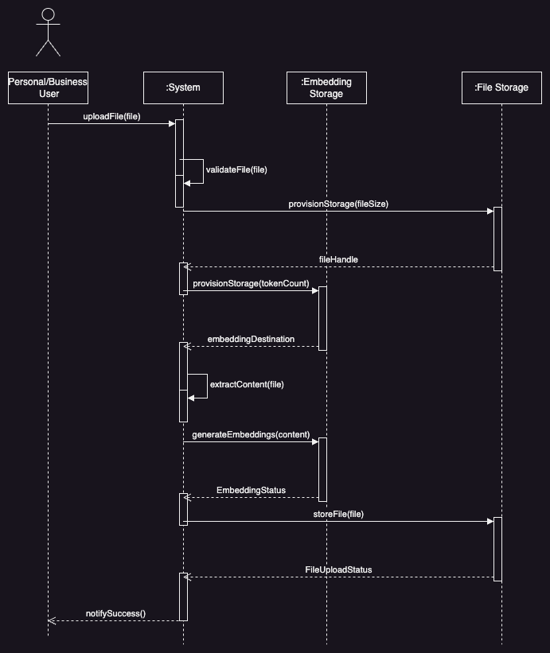
UC1: Document Upload
Notes:
The first use case is uploading a new document to the RAG platform. This involves the personal or business user providing a new file, for simplicity we can assume this is from local storage on their computer. This file is validated, then stored. Once stored the ingestion process begins this RAG system is built on vector search which allows for the document to be converted to a set of embeddings or a Tensor and stored along side the original document. This is then used in later use cases. As a simple example, you could consider if a user was tracking their personal finance documents they may upload their most recent credit card statement.

Slide 7
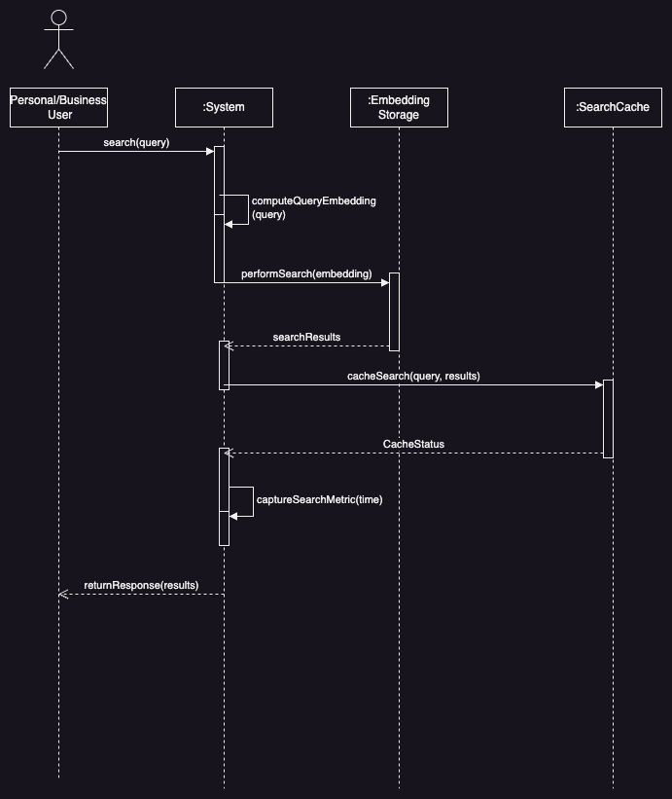
UC2: Perform Search
Notes:
This second use case builds on the first, assume a set of documents have already been uploaded. The personal or business user then submits a set of text to the platform. This is the request that will eventually be processed by the Gen AI platform. This could be a question such as “how much did I spend on groceries this month?”. This query will then be coverted to embeddings just like the documents that were uploaded and then a search will be performed, this can then be cached for commonly asked questions. The metrics for this processing will be stored off and the response returned.

Slide 8
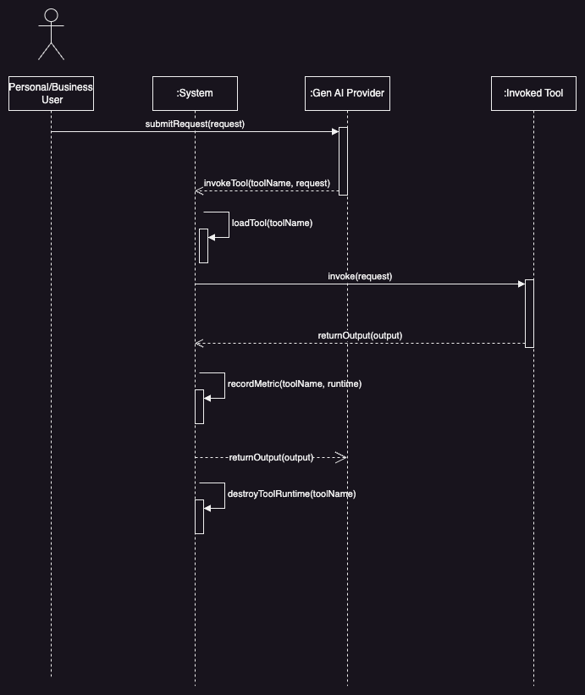
UC3: Tool Invoke
Notes:
The 3rd use case is built as an extension or alternative to use case 2. In this use case a tool such as “Pay my credit card bill” is invoked by the gen AI. The Ragady platform provides a container for this but does not provide the tools themselves. In this use case, the gen ai provider asks for the tool to be invoked, ragady loads and invokes the tool and records its metadata and returns the result

Slide 9
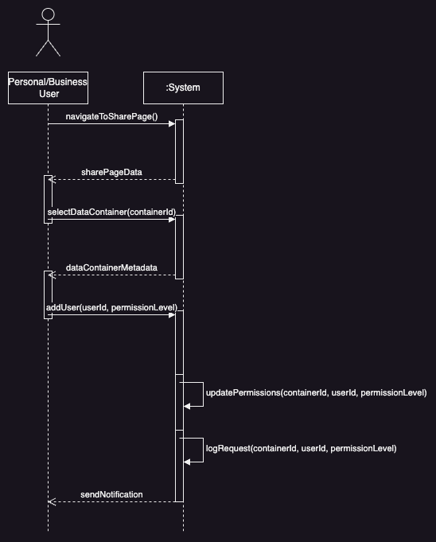
UC4: Grant Access to Data Container
Notes:
Use case 4 is focused more on the security aspect of the system. These data containers are a logical grouping of the documents and the embeddings for that set of documents. For business users, this can then be shared with other users. This diagram shows how role based access control is applied to these containers

Slide 10
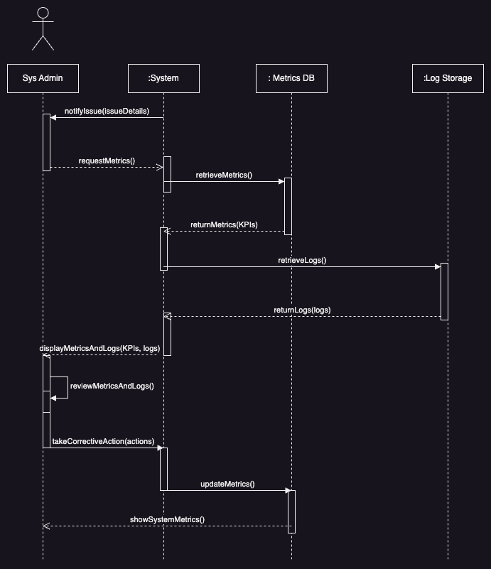
UC5: Review System Metrics
Notes:
The final use case focuses on the sys admin user architype who reviews and monitors each of the metrics for system health. In the previous use cases almost all of them except for use case 4, metrics were explicitly collected. In addition to this system level metrics such as node health will be collected and available for monitoring, as well as application logs. This use case shows how an admin would interact with the system and how the system would retrieve data from those stores to gather the appropriate data.

Slide 11
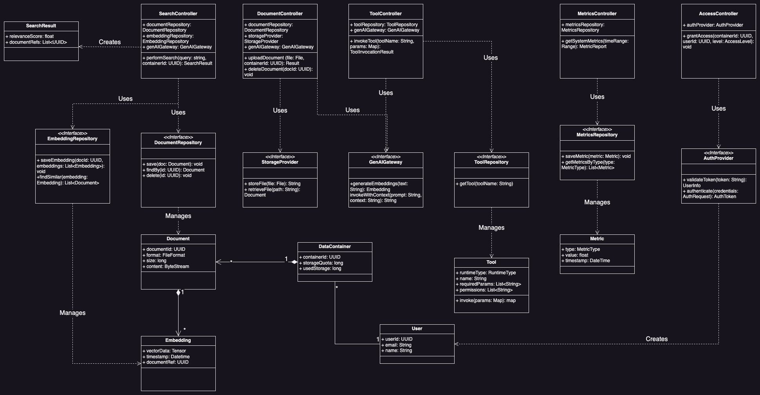
Class Diagram
Notes:
This class diagram represents the main classes used throughout the system. There’s a few items I would like to call out from GRASP the creator pattern is used to instantiate the classes such as Metric. Namely by the controllers. The controllers represent the controller pattern and separate the UI layer from the underlying objects. The use of repository interfaces and external service interfaces are a form of indirection. Finally, the repositories also reflect the pure fabrication pattern. Next the SOLID principles, each class is single responsibility, with strong interface segregation where high cohesion is strongly implemented. In addition, with the exceptions of the data objects, all of the interactions rely on interfaces not concrete classes. Gang of Four, This uses a singleton for all repositories, as they can more efficiently reuse connections, a bridge for interacting with Gen AI providers, and a command structure for executing tools in a custom sandbox

Slide 12
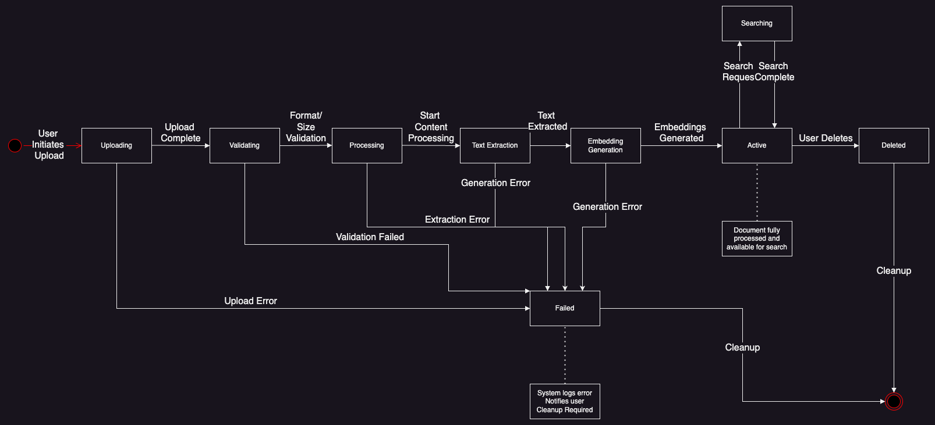
State Diagram
Notes:
This is a state diagram which walks through how the ingestion process occurs, first the document is validated, the content extracted, the embeddings are generated and its saved. There’s a few off ramps into a failure case when something fails in which case the user is informed and a user is notified

Slide 13
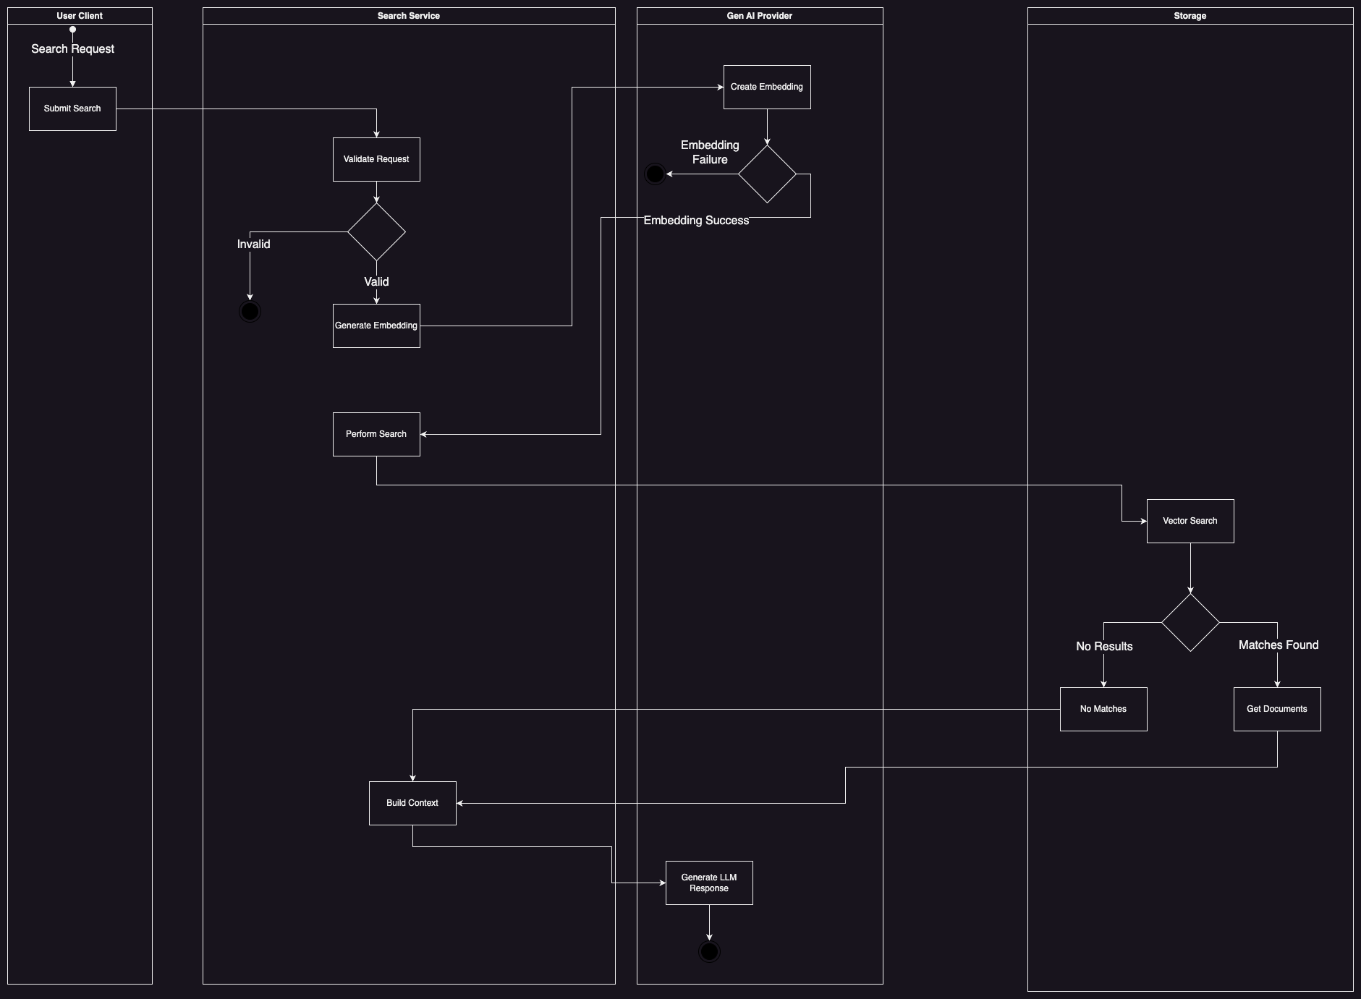
Activity Diagram
Notes:
This activity diagram shows a search as it goes through the 4 systems, it flows from the user’s client which could be a web browser or a 3rd party application. Some basic validation is performed on the length and other parameters, an embedding is generated, the gen AI provider creates this embedding and then its used to perform the actual search in the storage layer. Finally the context is assembled and provided to the large language model.

Slide 14
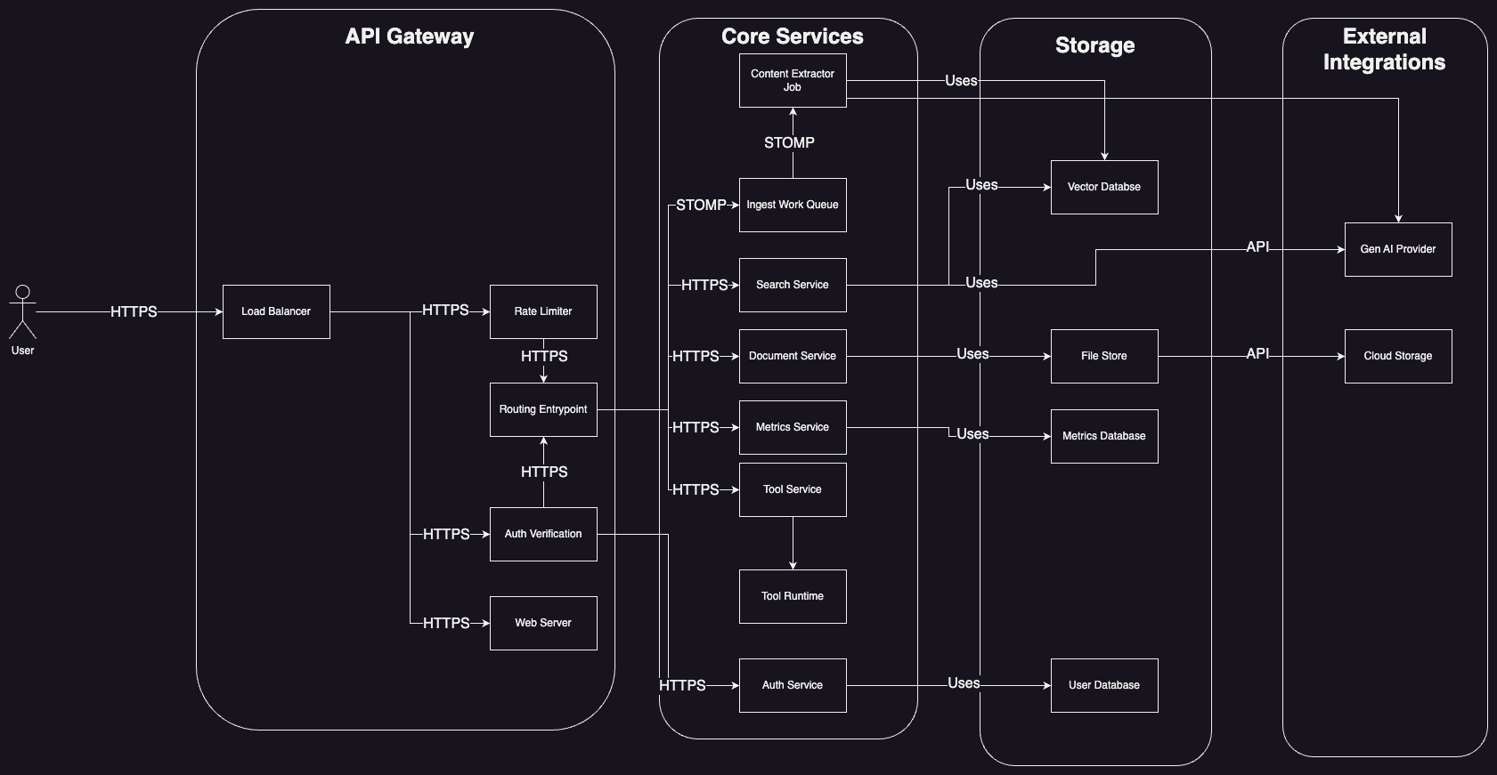
Component Diagram
Notes:
This shows a high level component diagram and highlights some of the core design decisions. The API gateway pattern is used to act as a gateway, and perform authentication/security checks. The Database per service is used where each service has its own dedicated database. Next it uses the event driven archicture pattern with the Ingest work queue which handles the longer running ingestion process. Finally it could use sagas to keep data consistent through all these interactions.

Slide 15
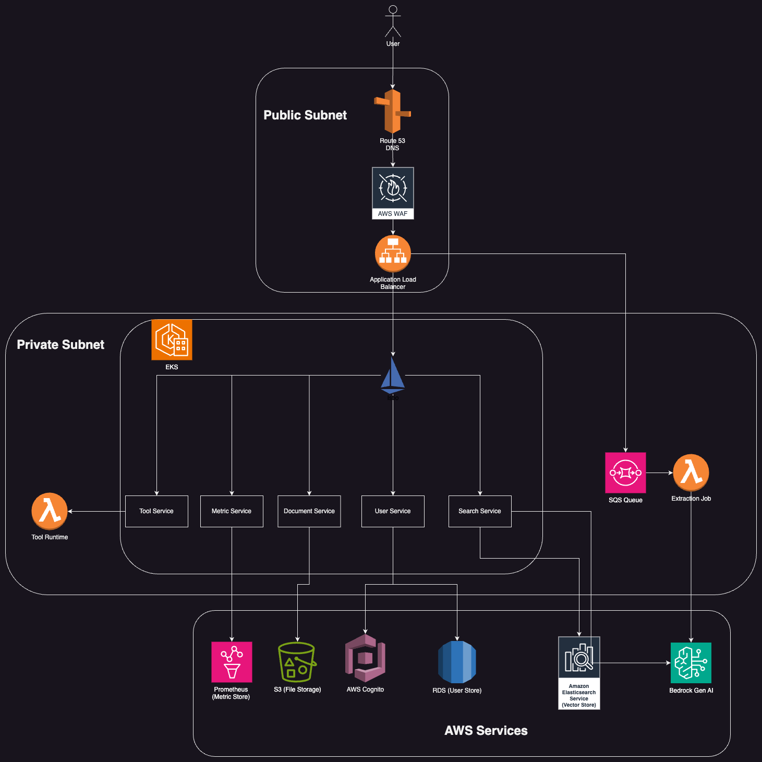
Deployment Diagram
Notes:
The AWS deployment diagram shows 3 different layers, a public portion which is available to the open internet, a private subnet enclave which contains our core services with stronger security roles and finally the AWS layer where AWS hoested services are present. Though not depected this architecture can be used in an active, passive setup with two copies in different regions with AWS Route 53 swapping between them. Due to the elastic nature its possible to achieve RTO and RPOs of minutes with minimal costs

Slide 16
Cost Estimate Primary Region
Service | Monthly ($)
Amazon Simple Queue Service (SQS) | 0
AWS Lambda | 326.67
Amazon RDS for PostgreSQL | 600.7
Amazon Managed Service for Prometheus | 384.2312
Application Load Balancer | 28.11
Amazon OpenSearch Service | 1382.73
Amazon Cognito | 5
S3 Standard | 23.04
Data Transfer | 0
Amazon EKS | 73
Amazon EC2 | 424.448
Total | 3245
Notes:
This explores the estimated costs for a nominal example, the documentation has a deeper description as to the decisions but this should be sufficient for a base offering to at least 100 concurrent users. The main cost drivers are from OpenSearch, there are some potential cost savings by using other vector storage methods, but OpenSearch allows for the easiest growth as the user count increases. In the document I outline how this can scale up to 100,000 concurrent users with fairly minimal changes to this architecture

Slide 17
Cost Estimate Secondary Region
Service | Monthly($)
AWS Fargate | 0
Application Load Balancer | 22.27
Amazon OpenSearch Service | 334.96
S3 Standard | 23
Data Transfer | 0
Amazon RDS for PostgreSQL | 80.85
Total | 460
Notes:
This is a cost estimate of the secondary passive site, as you can see the cost is very minimal, but with this architecture and route 53 health checks, a lambda could be executed to scale this up to the same size as the primary region within minutes. The change is to add pods to the EKS cluster using fargate, vertically size the OpenSearch Service as well as the RDS nodes. The reason for this approach is that the data will replicated over time, but to handle the inbound requests additional performance will be required. Horizontal scalling could be employeed but that would require replication which would slow down recovery time. This would allow for all the data to be present and the foucs is just on scaling compute which is a strong suite of AWS. This also would be completed by the time the Route 53 DNS record propagation has swapped to the other site providing for minimal downtime

Slide 18
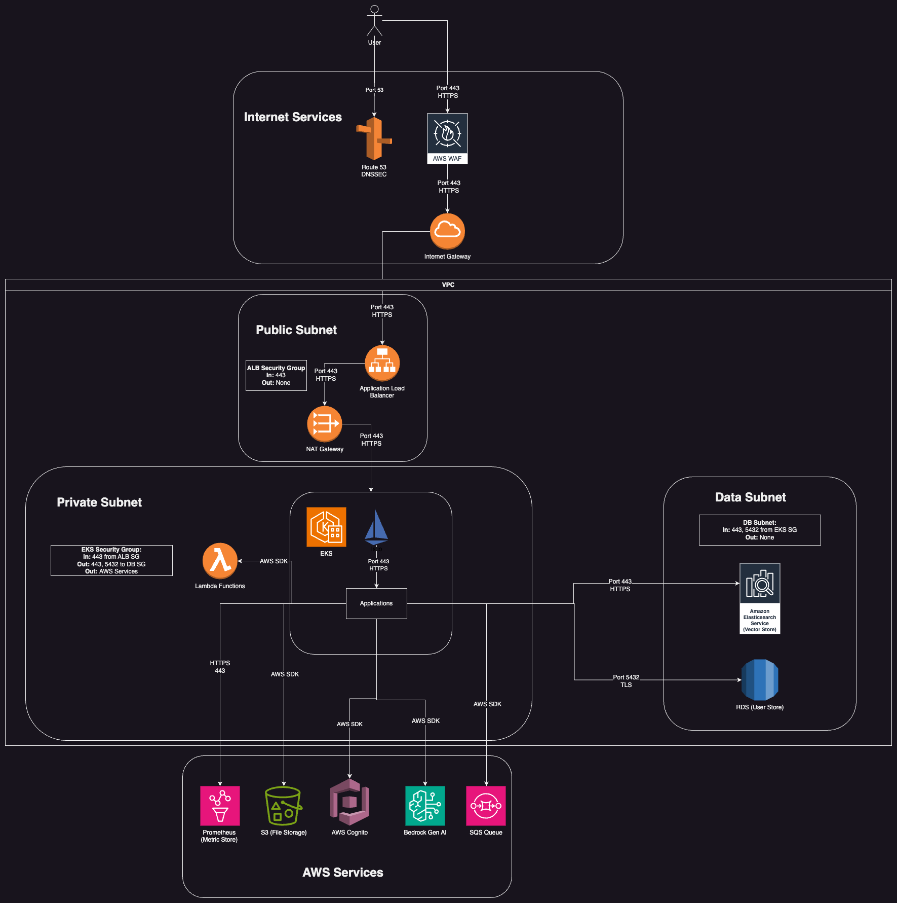
Security Diagram
Notes:
This is a slightly different view of the AWS architecture focused on security. It draws the subnets more explictlity and the security groups and protocols in more detail. But, in essence, the Public subnet can be accessed by the internet, the private subnet can be accessed by the public subnet but only through the ALB and Nat gateway, but the Datasubnet can only be access by the workers. Finally the AWS services can be reached.

Slide 19
Conclusions and Next steps
Explore additional clients
Implementation
Allowed for real life exploration of cloud principles

